Slide 1
Water Management
Serious Game
Prof. Tricia Stadnyk, P.Eng.
Canada Research Chair, Hydrological Modelling
University of Calgary
2024

Slide 2
Acknowledgement
This game has been adapted from The River Basin Game, developed for educational use by
Arjen Hoekstra
University of Twente, the Netherlands
©2007
A. Y. Hoekstra, “Computer-supported games and role plays in teaching water management,” Hydrol Earth Syst Sci, vol. 16, no. 8, pp. 2985–2994, Aug. 2012, doi: 10.5194/hess-16-2985-2012.

Slide 3

The Setting
12 Farmers per River Basin (class divided into 2 river basins), each competing for water for their crops
Water is the Limiting Factor
3 reaches (subbasins): upstream, midstream, downstream
Different costs of living for each farmer (in $ 10³ per year)
Each game is 8 rounds (8 years)
5 minutes of negotiation + 10 minutes of feedback and discussion
Notes:
3

Slide 4
The Aim
Make money to support your family (by farming only)
Overall success of your river basin as a whole (all reaches combined) determines the WINNERS of the game
Net Benefit of the basin
Costs = pumping water (abstraction) + cost of living
Gross benefit = fair market price for crops produced
Net benefit = Gross benefit – Total cost
Notes:
4

Slide 5
Cost of Water Abstraction
Total cost = (Number of water units x average unit cost) + cost of living
Average cost per unit of water:
Increases as you and the other farmers in your subbasin abstract more water
Starts at $1 in first round
$1+n in subsequent rounds, n= depletion of storage (amount abstracted from previous rounds)
Each additional water unit costs an additional $1
Notes:
5

Slide 6
Benefit of Water Abstraction
You will EARN money by selling the crops that your water units grow
Gross benefit = Units of water abstracted x benefit per unit (in $)
Benefit per unit (to start) = $ 50/unit
Cost per unit of water could fluctuate with market conditions
Law of Supply and Demand
Notes:
6
Fluctate the benefit of water? Drought conditions – higher, wet conditions, lower
K value?

Slide 7
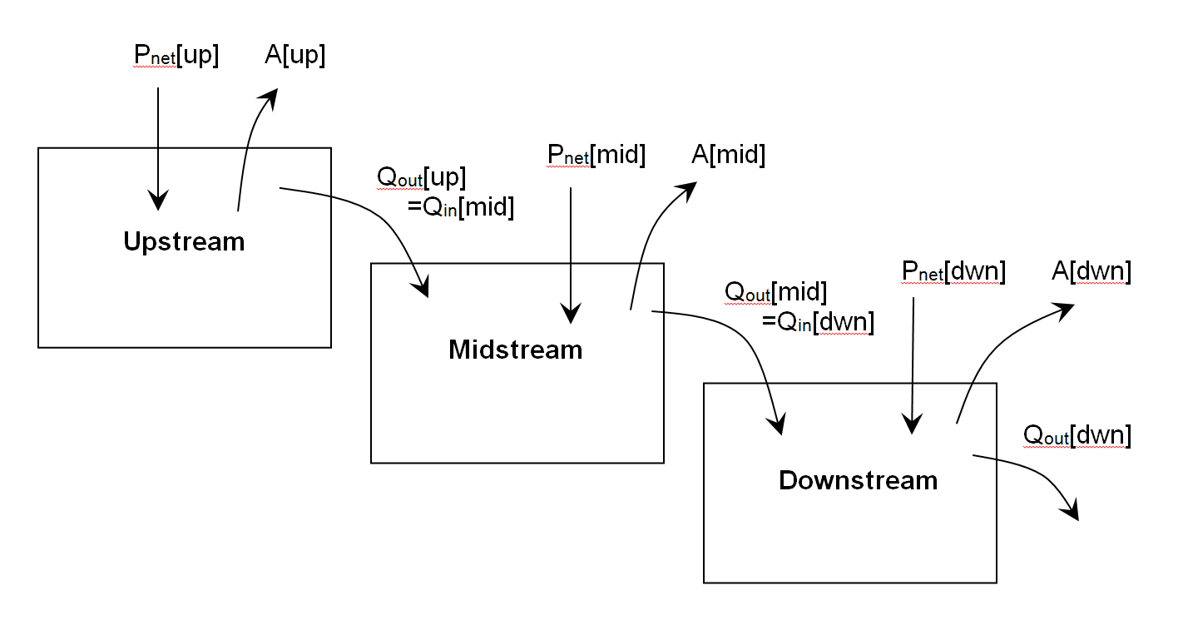
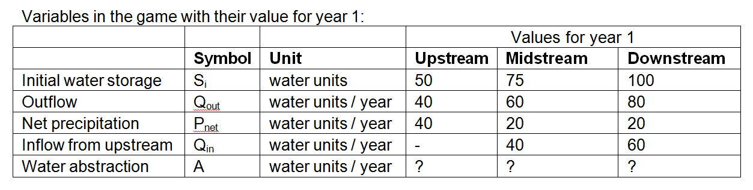
Hydrology of the River Basins
NOTES:
Climate has been
unpredictable within the basin in recent years
+
Governments are considering equitable water-share agreements, but so far can’t agree on terms…
dS = P_{net} + Q_{in} – Q_{out} – A
Q_{out} = S_{i} / k, k = 1.25 year
Notes:
7

Slide 8
Cost of Living (in 10³ $ per year)
Farmer 1 ($30)
Farmer 2 ($24)
Farmer 3 ($16)
Farmer 4 ($12)
Farmer 1 ($18)
Farmer 2 ($12)
Farmer 3 ($10)
Farmer 4 ($8)
$6 / farmer
Upstream
Midstream
Downstream

Slide 9
Who Is Who in this Game?
Instructor’s Role: Water licenser (Government)
Teaching Assistant Role(s): 1 per river basin as ‘enforcement officers’
Student role(s): each of you will play a farmer allocated to a specific subbasin within one of two river basins
Two games (River basins) are being playing simultaneously
Three reaches or subbasins within each basin
Upstream, Middle, Downstream
Everyone will be given a unique cost of living based on operations costs for their farm, and cost of living in their region
Everyone will play 2 games (8 rounds per game) total
Notes:
UPDATE

Slide 10
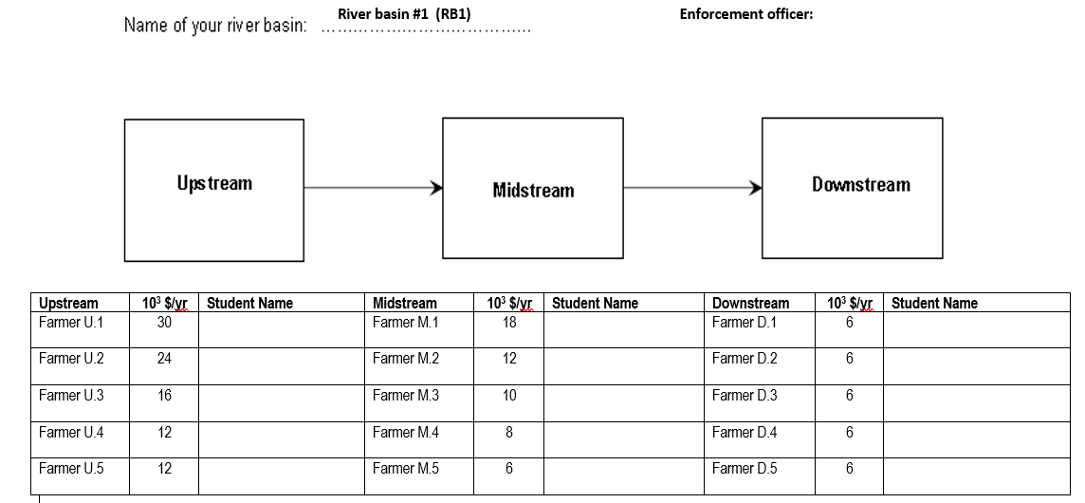
River Basin #1 (RB1)
Notes:
Assign roles of each participant (add names)

Slide 11
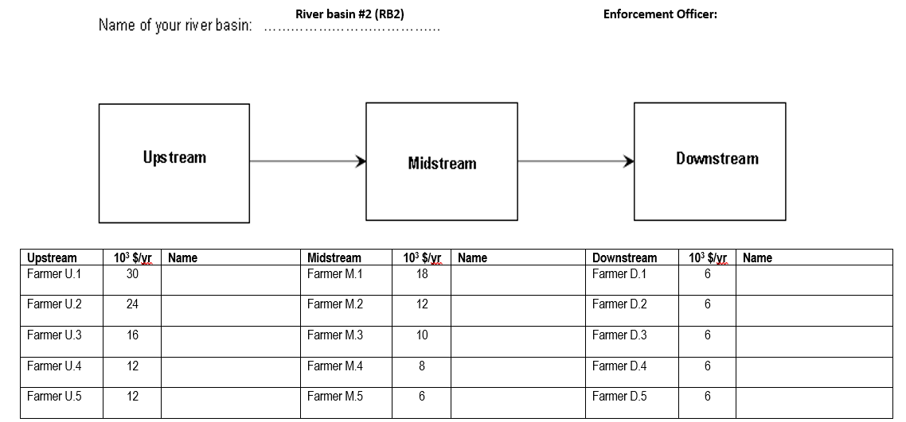
River Basin #2 (RB2)
Notes:
Play 2 river basins only if class/participant enrolment is sufficient
Assign roles of each participant (add names)

Slide 12
Instructions
Negotiate only with farmers in your subbasin (reach)
Discuss individual abstractions based on total storage available and funds available
Each subbasin (cooperative) sets the terms of their negotiations
All final abstractions by individual farmers are CONFIDENTIAL and in order of farmer number
MAX 5 minutes for negotiating. When time is up, all farmers will be required to (confidentially) write down and submit abstractions to enforcement officers.
Max 5 minutes to log your abstractions with the River Basin coordinator
These will be submitted to the government
Updated river basin conditions and water unit costs will be provided at the end of each round
Total abstraction cannot exceed total storage available

Slide 13
Instructions (cont’d)
Subbasin cooperatives can renegotiate their own terms of negotiation while results are being tallied (~10 min discussion)
Cost of living will be subtracted each round (whether you make a profit or not); each farmer is provided with a unique cost of living (based on cost of farming operation and market value)
Winners selected based on Maximum Net Benefit of the River Basin after 8 rounds of play (8 years)

Slide 14
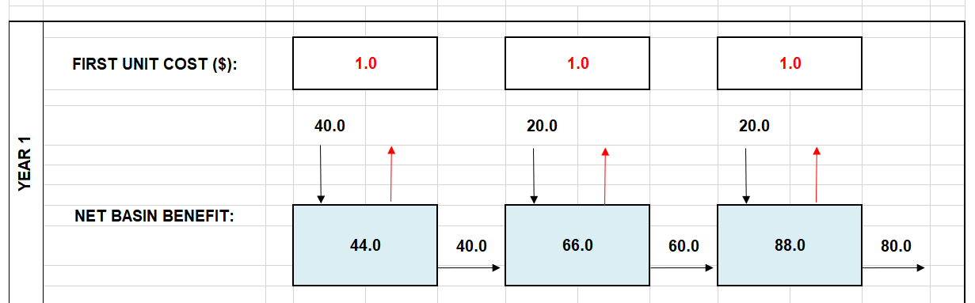
Feedback You Will Receive
Public: Adjusted water balance for next round (P, S, Q per reach)
Private: How many water units were allocated to you, and updated bank account balance

Slide 15
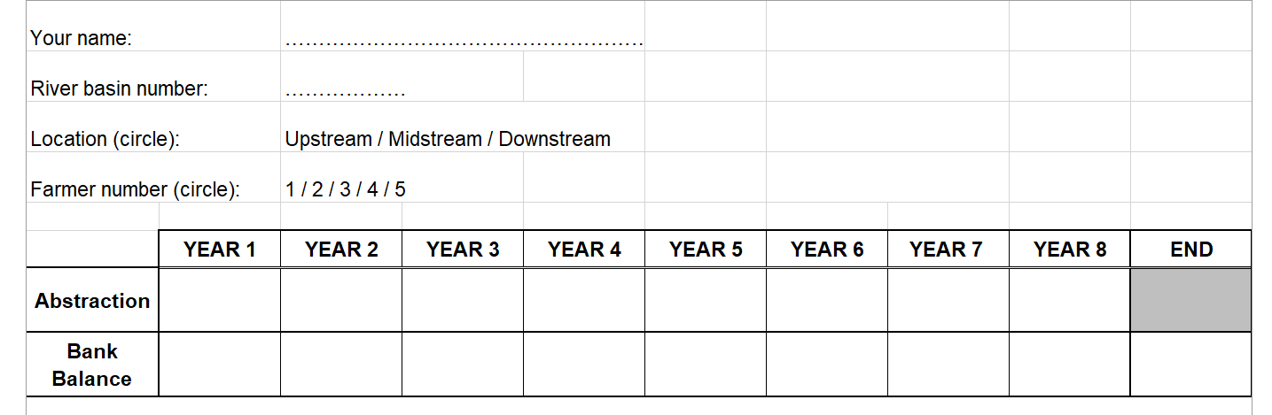
Decision Sheet
Each round of the game, you will submit (confidentially) the following decision sheet to your Enforcement Officer:
It will be returned with your updated bank balance

Slide 16
The Plan/Schedule
The SG is designed to be played over the course of 3x 50-min lectures:
Day 1: Introduce the game, the rules, and play 2-4 rounds of Game 1
Day 2 – complete Game 1 (4-6 rounds). Play Game 2 (new conditions imposed)
Day 3 – Wrap up lecture on Sustainable Water Management Principles that connect to the SG

Slide 17
To Prepare Yourself…
Consider the following questions
What is MY objective as a farmer?
Put food on your family's table
Save money in the bank
How do you balance that with watershed sustainability?
Short- versus long-term considerations?
What are other people’s objectives?
What are the benefits of working as/in a cooperative?
What is sustainable water use?
How can I (can I?) achieve that with multiple (sometimes competing) objectives?
What is good for sustainability of my reach? The whole basin?
What are the knowns? (i.e., inflows, storage, outflows)
What are the known unknowns? (i.e., climate change, upstream use, etc.?)
What are the unknown unknowns (i.e., the human factor)

